Slide 1
Narrative and Simulation in Interactive Dialogue
Emily Short
@emshort
http://emshort.wordpress.com
Notes:
Greetings, and thank you for having me here.
I’m Emily Short, and I work on conversation in games. My aim for this morning is to talk about interactive dialogue through the lens of a particular project, a Roman thriller called Blood & Laurels>>

Slide 2
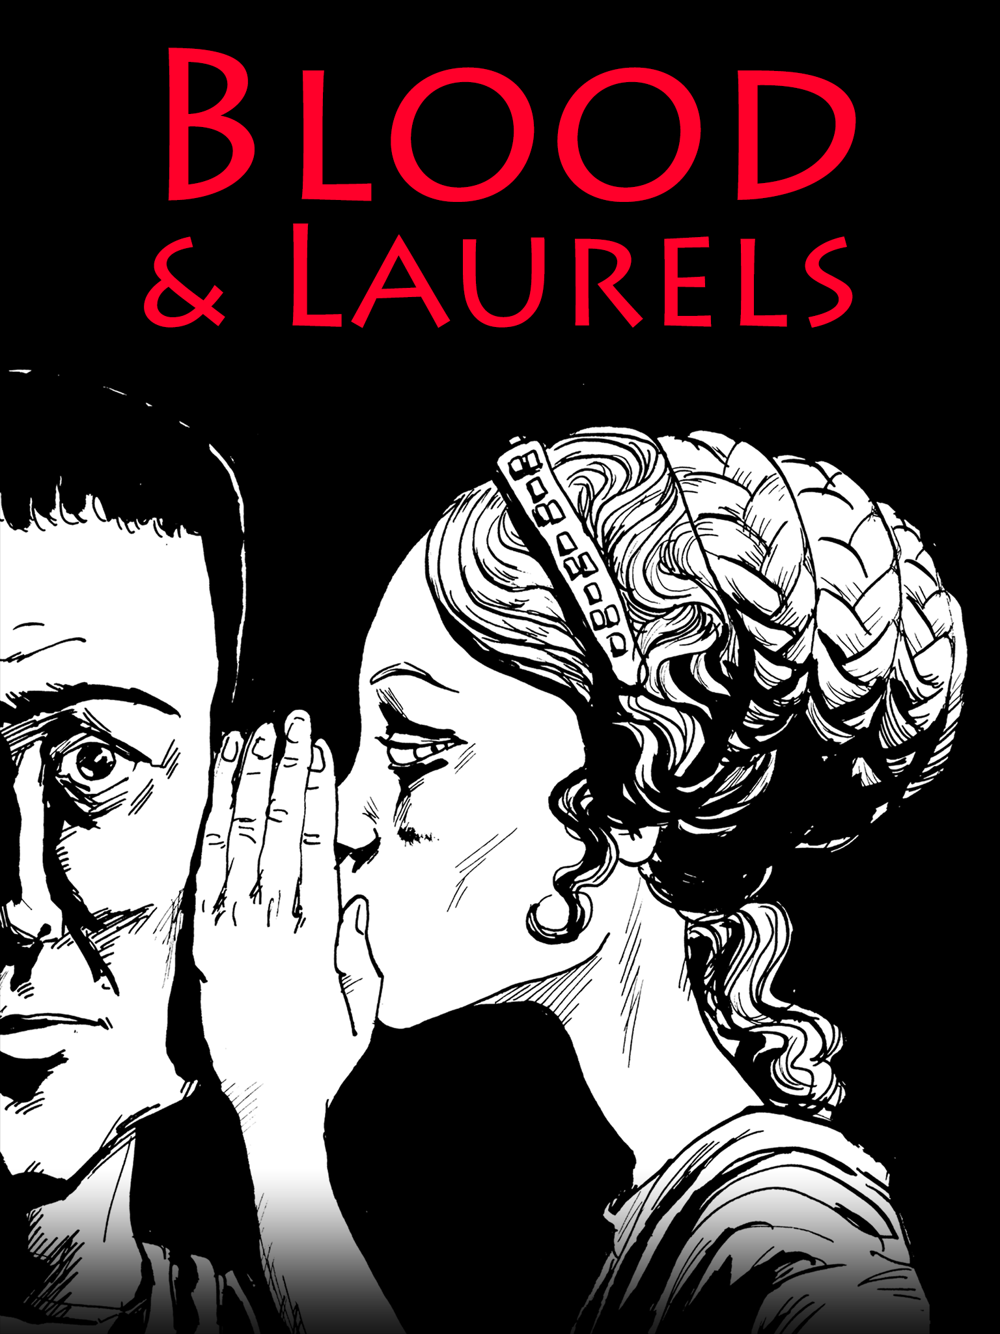
Blood & Laurels
Cults, prophecies, poison, intrigue.
Imperial tropefest.
Notes:
…that launched this summer for iPad. To do that I’ll be giving a very brief overview of my work up to that point, then talk about the project aims, tools, and approaches for Blood & Laurels, and finally look at what we can learn from response to the work.
I should frame by mentioning that Blood & Laurels was developed as a commercial project, originally supported by Linden Lab and then launched on our own. So the project lacks a lot of the purity of a research project: we weren’t trying to refine and test one specific thing, but on the contrary trying to accomplish a whole load of different objectives at once, some of them my objectives, some of them provided for me by management; and then we don’t have research-style feedback, either. We were fortunate, though, to receive a number of thoughtful in-depth reviews and player responses both from mobile gaming websites and from the interactive fiction community, and I will be using that material as a qualitative, if not a quantitative, measure of where we succeeded and where there is still work to be done.

Slide 3
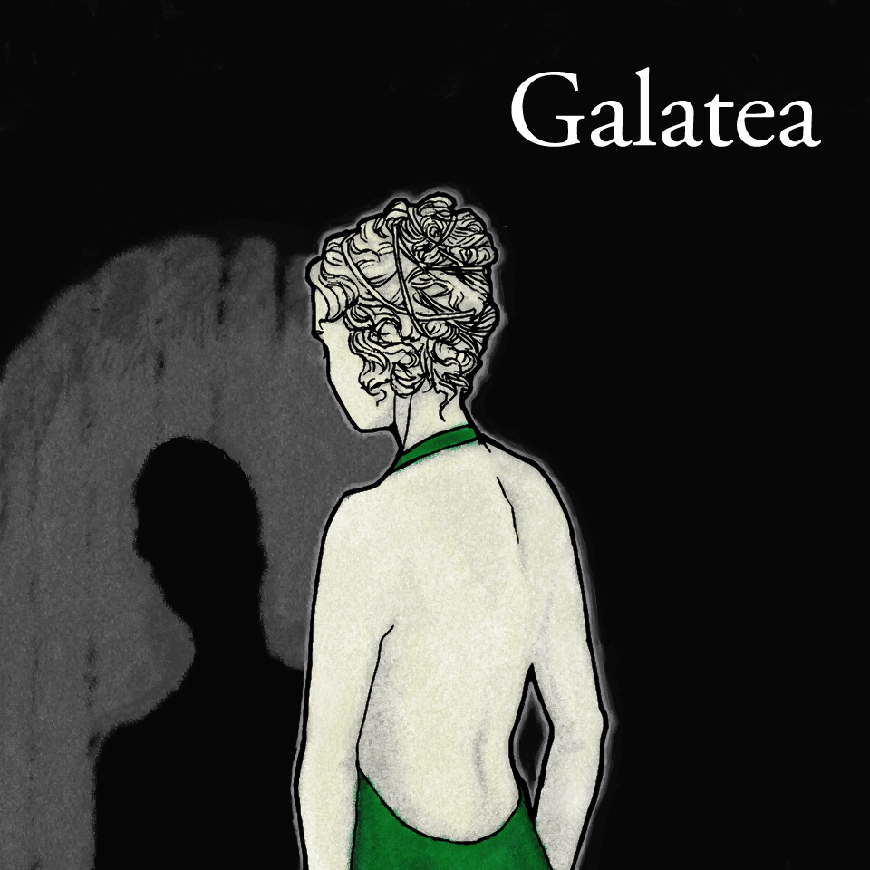
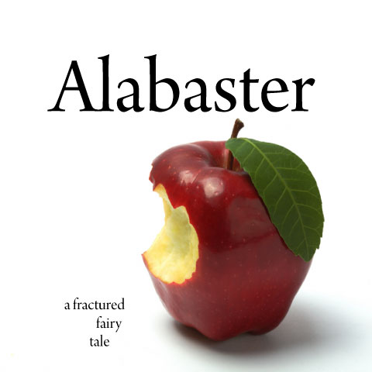

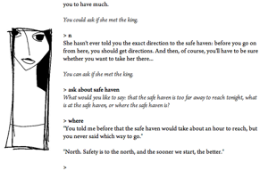
Prior Work
Choice-based,
running on Versu engine
Parser-based interactive fiction
Notes:
I’ve been working in this area for about fifteen years now – here are some of the previous works I’ve built with a heavily conversation focus.

Slide 4
Conversation Design Goals
Explorability: Player is free to explore dialogue space
Notes:
Over the course of these projects, I’ve been working towards a mostly in-my-head idea of what I’d like interactive dialogue to feel like in my games.
First of all, I want it to feel explorable, and explorable in a way that conversation trees typically are not. That is, I want the player to be able to become curious about different ideas introduced in the conversation and choose to follow up on those ideas in more depth; I want there to be enough options at a time that the player doesn’t feel obligated to try all the dialogue options, the way one often does with a dialogue tree.

Slide 5
Conversation Design Goals
Explorability: Player is free to explore dialogue space
Expressiveness: Player and NPC can signal emotional states as well as information
Notes:
I want dialogue to include expressive agency as well, particularly through gestures and emotional cues: when I was collecting transcripts from parser-based conversation games, I found that players would type instructions to do things like smile or laugh or cry at appropriate times in the dialogue, even if they didn’t really think those actions were accounted for, and it helps them feel that they are part of an improvisational role-playing experience.

Slide 6
Conversation Design Goals
Explorability: Player is free to explore dialogue space
Expressiveness: Player and NPC can signal emotional states as well as information
Pacing: story moves forward on its own when the player is out of things to say
Notes:
This is something that was missing in my early work (such as Galatea): characters were capable of responding to prompts, but (except with rare, hand-coded exceptions) would not move the story forward on their own. Trick here is partly figuring out when the player is done pursuing a particular line of conversation and it’s safe to move on. The trick here is actually not to make the NPC take the lead as much of the time as the player does — I did an experiment with that and players described the character as “pushy” and “arrogant” and “obnoxious” — so instead what I’m aiming for is finding the moments where the player is no longer pursuing a line of her own and cueing the NPC to move the story forward at that point.
This of course assumes that the conversation work we’re doing is embedded in some kind of overall narrative framework, which is indeed generally what I’m trying to do.

Slide 7
Conversation Design Goals
Explorability: Player is free to explore dialogue space
Expressiveness: Player and NPC can signal emotional states as well as information
Pacing: story moves forward on its own when the player is out of things to say
Characters appear as entities with convincing emotional states
  Player agency involves manipulating characters
  Player responds to characters in non-utilitarian way
Notes:
Two sub-goals of this, which are maybe not always compatible, but I think they can play off one another in interesting ways in practice: character manipulation vs. actually being invested in the feelings of the character. A lot of the moral energy of a story can emerge from this consideration.

Slide 8
Tool Goals
Authoring
  Easy to generate large quantities of content, at least 10x as much as the player is likely to encounter in a single play-through
  Easy to revise content once created
Notes:
rapid writing ("authorability")

Slide 9
Tool Goals
Authoring
  Easy to generate large quantities of content, at least 10x as much as the player is likely to encounter in a single play-through
  Easy to revise content once created
Testing
  Easy to verify that there are no “stuck” states from which dialogue cannot proceed
Notes:
rapid writing ("authorability")

Slide 10
“Threaded Conversation”
Quips represent actual lines of non-repeatable dialogue (“The Emperor is looking ill these days”)
Quips are tagged with one or more topics
Relations between quips (direct and indirect following)
Factual and emotional data associated with quips
  Prerequisites
  Outcomes
Notes:
So the point I’d reached with this work before Blood & Laurels and its kin was to develop a conversation library for the free text adventure language Inform 7 which implements these basic ideas.
Conversation consists of a number of quips, which are individual things to say; quips are tagged with information including one or more topics of conversation that they’re about; relationships between quips, so we can say that one quip must follow another specific quip; and factual or emotional data associated with those quips.
It’s important to note this is meant to be kind of an all-purpose structure that can be used to construct story content of multiple types; sometimes it might be giving the player back-story on a topic, sometimes it might be laying out quest assignments, sometimes it might be negotiating stages of a particular type of social interaction such as inviting someone out or asking them to a play. So in contrast with something like Prom Week where it’s possible to think of aligning all pieces of text with particular social situations and their affordances, here we can’t make those kinds of abstractions.
Implementation for Inform 7 is available online; several discussions of using this tool practically can be found on my blog

Slide 11
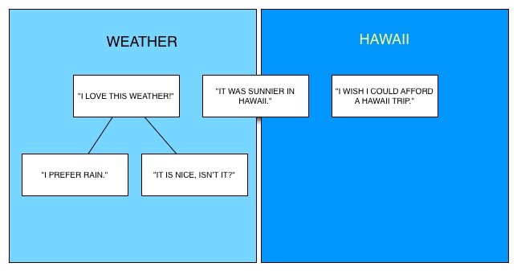
Notes:
So the reason I call this threaded conversation is that, if you map out the “direct following” relationships between multiple quips, you wind up with a picture of a lot of short threads or short trees, often two or three beats long.
At any given moment, you can either continue with the thread you’re on (if there’s more to say about that thread), or you can shift to another quip that shares the same topic, as long as all the prerequisites are met.

Slide 12
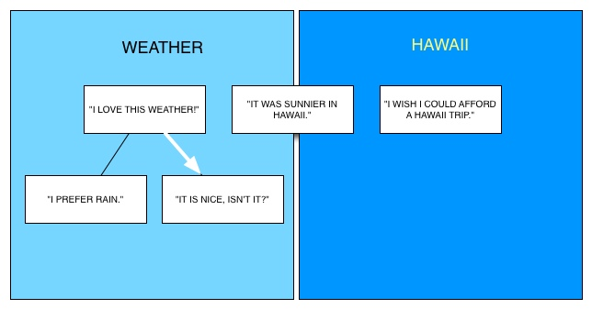
Notes:
So the reason I call this threaded conversation is that, if you map out the “direct following” relationships between multiple quips, you wind up with a picture of a lot of short threads or short trees, often two or three beats long.
At any given moment, you can either continue with the thread you’re on (if there’s more to say about that thread), or you can shift to another quip that shares the same topic, as long as all the prerequisites are met.

Slide 13

Notes:
So the reason I call this threaded conversation is that, if you map out the “direct following” relationships between multiple quips, you wind up with a picture of a lot of short threads or short trees, often two or three beats long.
At any given moment, you can either continue with the thread you’re on (if there’s more to say about that thread), or you can shift to another quip that shares the same topic, as long as all the prerequisites are met.

Slide 14
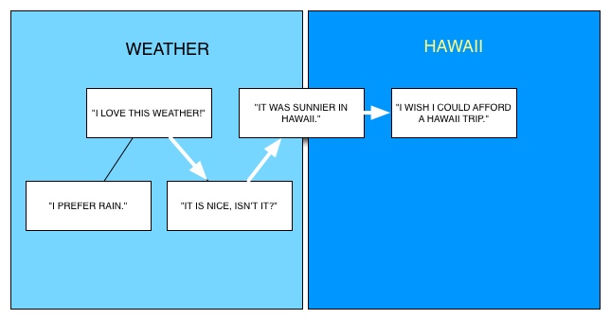
Notes:
So the reason I call this threaded conversation is that, if you map out the “direct following” relationships between multiple quips, you wind up with a picture of a lot of short threads or short trees, often two or three beats long.
At any given moment, you can either continue with the thread you’re on (if there’s more to say about that thread), or you can shift to another quip that shares the same topic, as long as all the prerequisites are met.

Slide 15

Notes:
So the reason I call this threaded conversation is that, if you map out the “direct following” relationships between multiple quips, you wind up with a picture of a lot of short threads or short trees, often two or three beats long.
At any given moment, you can either continue with the thread you’re on (if there’s more to say about that thread), or you can shift to another quip that shares the same topic, as long as all the prerequisites are met.

Slide 17
Blood & Laurels
Versu AI engine + Threaded Conversation dialogue model
More about Versu at versu.com
Notes:
Blood & Laurels is my most recent foray into this area. It is built on the Versu AI engine, an engine designed by Richard Evans (2 minute thumb sketch of Versu);
emphasize possibility of doing something more abstract with it.
The Threaded Conversation behavior that I just described is built into the Library for Versu. So the way this works is that the social practice model determines whose turn it is to speak in a conversation and what’s appropriate to say next; the threaded conversation model provides specific, single-use dialogue that can be used in this particular instantiation. So the social practice is “engage in conversation,” but the exact selection of conversational affordances to pick from is determined by the threaded conversation model.
Conversation affordances are presented alongside affordances from other social practices, so that the characters can play out scenes for instance of eating a banquet meal while talking about politics.
There’s more available about Versu on the versu.com website, including links to some papers that Richard and I have written about how it works, should you be interested in digging more into that.

Slide 18
Project-Specific Goals
Large story with many relationship configurations
Multiple ways of enacting the protagonist role
Richly branching narrative, high variability within scenes
Notes:
talk to slide

Slide 19
Project-Specific Goals
Large story with many relationship configurations
Multiple ways of enacting the protagonist role
Richly branching narrative, high variability within scenes
90-120 minutes of play time per complete reading
Notes:
Aims and Constraints on creating B&L
Aims, artistic
present a large story with a number of different relationship configs
allow the player to pursue a particular portrayal of Marcus
allow the player to pursue various relationships with other chars
Aims, marketing
accessible, book-like, high-stakes thriller

Slide 20
Project-Specific Goals
Large story with many relationship configurations
Multiple ways of enacting the protagonist role
Richly branching narrative, high variability within scenes
90-120 minutes of play time per complete reading
Accessible, book-like style
High-stakes thriller plot
Numerous achievements for the player to unlock
Notes:
Aims and Constraints on creating B&L
Aims, artistic
present a large story with a number of different relationship configs
allow the player to pursue a particular portrayal of Marcus
allow the player to pursue various relationships with other chars
Aims, marketing
accessible, book-like, high-stakes thriller

Slide 21
Project-Specific Goals
Large story with many relationship configurations
Multiple ways of enacting the protagonist role
Richly branching narrative, high variability within scenes
90-120 minutes of play time per complete reading
Accessible, book-like style
High-stakes thriller plot
Numerous achievements for the player to unlock
Finished, illustrated, and ready for QA in 2 months

Slide 22
Areas of Assessment
Authorability (speed, scope)
Pacing/Narrative Coherence
Agency based on “Social Physics”
Character Persuasiveness / Empathy
Notes:
That’s a lot to cover. For the purposes of this talk, though, I’m going to go over how we accomplished what we did accomplish, and then assess the project in four areas: authorability, pacing/narrative coherence, the degree to which the “social physics” provided a sense of agency, and the persuasiveness of the characters

Slide 23
Library Development: TC
Threaded Conversation-style dialogue marked up for Versu to indicate emotional content and social actions
Conversation
Interrogate Artus about cult (tagged be_assertive)
Tell Artus about the Emperor
Other Social Practices
Flatter Artus
Pose assertively
Notes:
We augmented the threaded conversation behavior so that quips were marked up with emotional content and social actions. So for instance you could have a line of dialogue that was both a question specific to the story and an assertive action, and the action would open up social practices for another character to respond to that kind of treatment (by being argumentative, trying to put you in your place, etc).
At the same time, there were also some affordances that had more all-purpose text that could go anywhere in the story – for instance if you’d already formed a good opinion of Artus, you might then have the option to flatter him in some way that referred back to that earlier incident. These social practices included some options for flirting with characters or trying to kill them off, and usually opening up the full range of those practices required the player to first decide, “yeah, I’m going to make that person my enemy” – so the player is first given some agency to decide what his character is trying to accomplish, and then a social practice toolkit for pursuing it.
The goal here: create a narrative context where relationships matter a lot, then let the player reach various outcomes by pushing relationships in appropriate directions

Slide 24
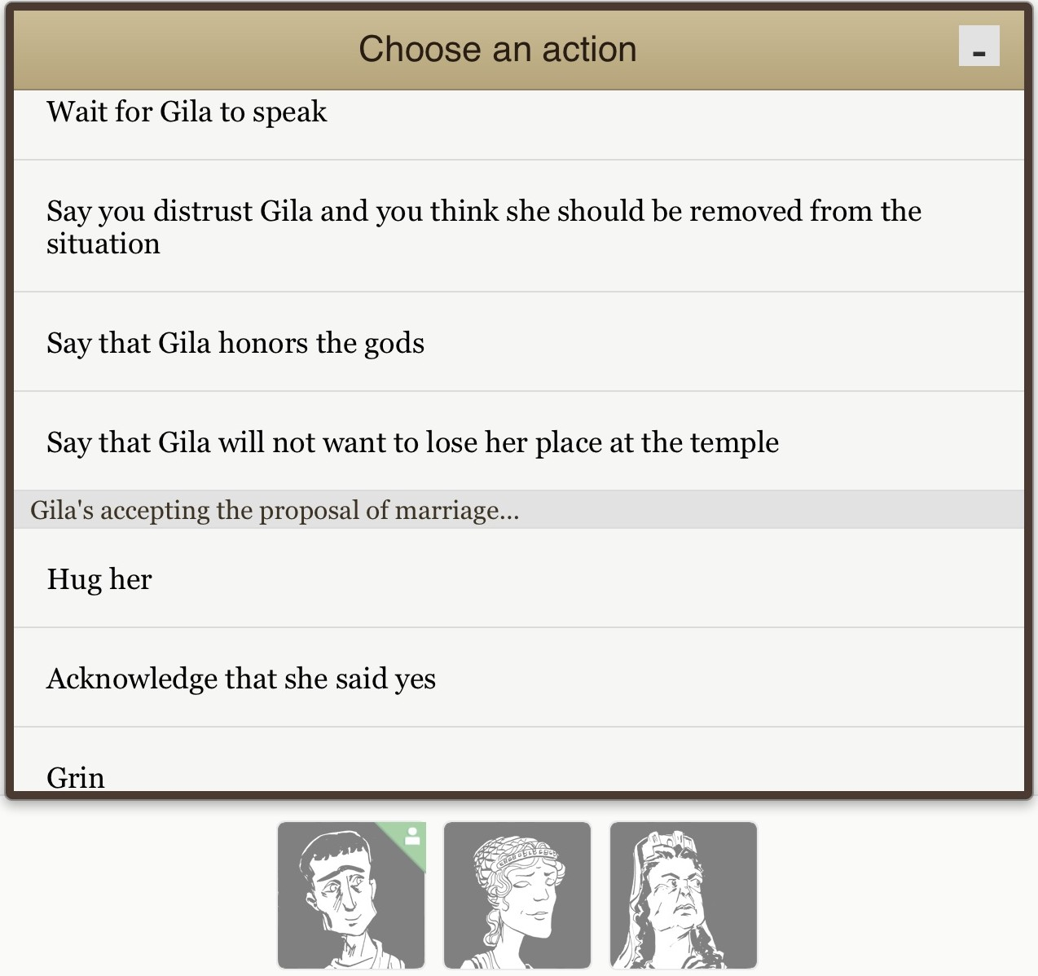
Notes:
So here’s how that would look in terms of available player actions.

Slide 25
Library Development: TC
Topic-specific exposition (“memories”)
“Filler” dialogue relating to various topics that appear in a number of scenes
“Pause” text for when the conversation thread had been dropped and we want to allow a transition
Notes:
We also added a couple of other features to support a smooth presentation of the narrative.
First of all, there are paragraphs of backstory exposition explaining things about the protagonist’s life and relationship to other characters. They’re tagged per topic, and they’re automatically dropped in when that topic is first brought up in Marcus’s presence. So the effect is that a line or two of dialogue plays introducing this new discussion area and then the internal monologue is supplied automatically to give it some context. As far as I can tell this worked so smoothly that no one ever realized the exposition wasn’t written directly into the dialogue as a single piece.
Filler dialogue is generic small talk about various topics that characters can use if they have nothing scene-specific that they need to say. This is most useful during big crowd scenes like banquets where it’s possible that not every NPC who could possibly be in the room will have something to say, but you want to keep conversation moving.
Finally, pause text is a line usually of environmental description – log snapping in the fireplace, something like that – which suggests a short delay between pieces of dialogue. This is used when the player has come to the end of a thread or has stopped pursuing the conversation topics that are currently in scope, and the NPCs have nothing pressing to add, so we want to allow a transition to other dialogue on a fresh topic.

Slide 26
Library Development: Scenes
  Exploration scenes — end when the player has either explored dialogue or stopped doing dialogue exploration
  Forking scenes — end in several ways when specific things are achieved
  Key decision scenes — very short decision points with focused interaction
Notes:
As another important piece of scaffolding for building a large story, we divided content into scenes, each of which could contain specific dialogue. There were also quips that were written to be available at any time, so it could appear in any scene when the necessary prerequisites were met.
scene design
exploration scenes:
allow the player to explicitly move the scene on when desired
allow scenes also to time out
forking scenes
have the scene end when particular states are achieved --
e.g. you've made friends w/a particular character
timeout as well
short timed scenes
specific number of turns long
focused on intense mandatory decisions
In practice what we’re doing is modeling different types of things in different layers of the system. So the social practice of conversation as modeled by the Versu engine – which tracks who gets to speak next and so on – is based in part on actual studies of conversational behavior and is attempting to be as mimetic and naturalistic as possible in determining who acts when. Some of the flirtation affordances, meanwhile, are structured in a more gamelike way, to reward the player for putting in more or less flirtation feedback at different times. Meanwhile the scenes themselves are about modeling narrative structure and in a very hand-rolled way producing escalation and story progress.

Slide 27
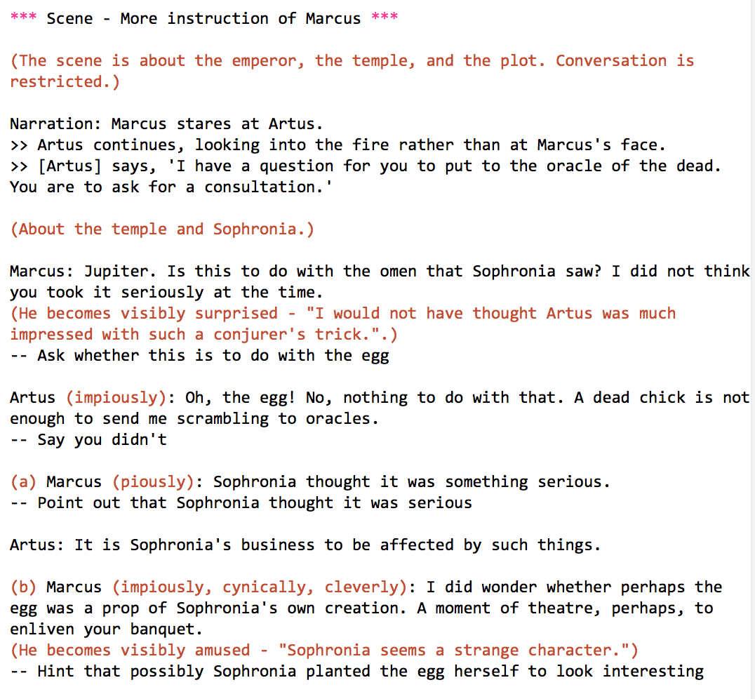
Tools Development: Prompter
Developed with Graham Nelson, creator of Inform
Tool for creating Threaded-Conversation-style content in a familiar screen-play like format
Notes:
Tools and approaches used
Praxis library, what's already implemented in it
Prompter, how that works, what's possible to build

Slide 28
Artus (very disloyally): The Emperor is a tyrant and a madman. His appetites are disgusting, his use of Imperial troops misguided, and even his taste in dress is not above reproach. Someone will kill him sooner or later. I would prefer that his replacement not be another mad tyrant.
(a) Marcus: His taste in dress...?
-- Ask what is wrong with the Emperor's clothes
Artus: He wears tassels on his leg, like a gladiator, to mark how many great men he has defeated. Gold tassels for men of the senatorial class, silver for equestrians.
(b) Marcus: I see how it might displease you to watch the Emperor make blunders with the army.
-- Sympathize with Artus's dislike of seeing the troops misused
Notes:
For instance, here’s an example of what a bit of this looked like…

Slide 29
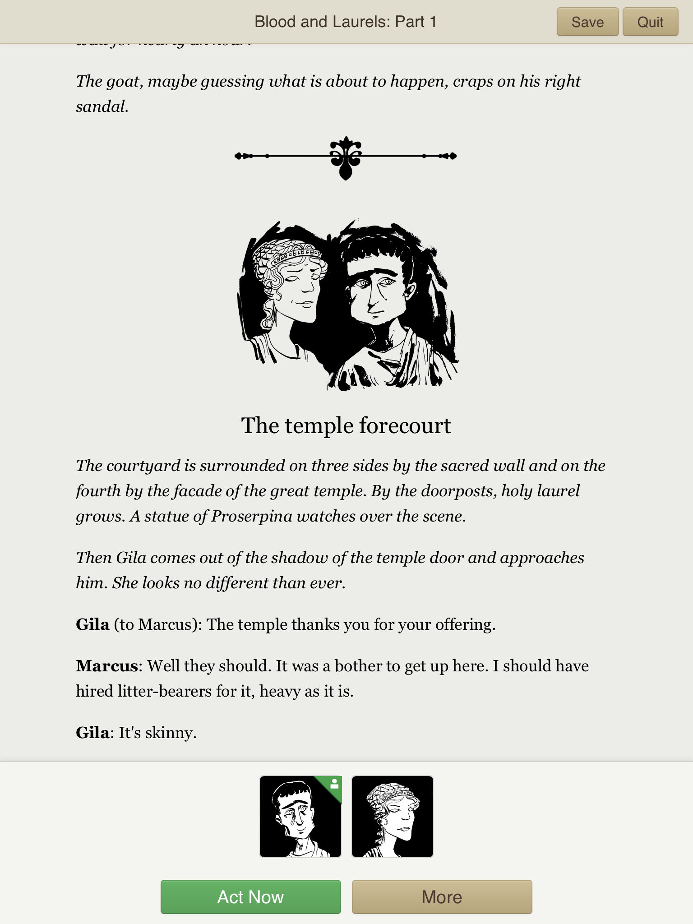

Slide 30
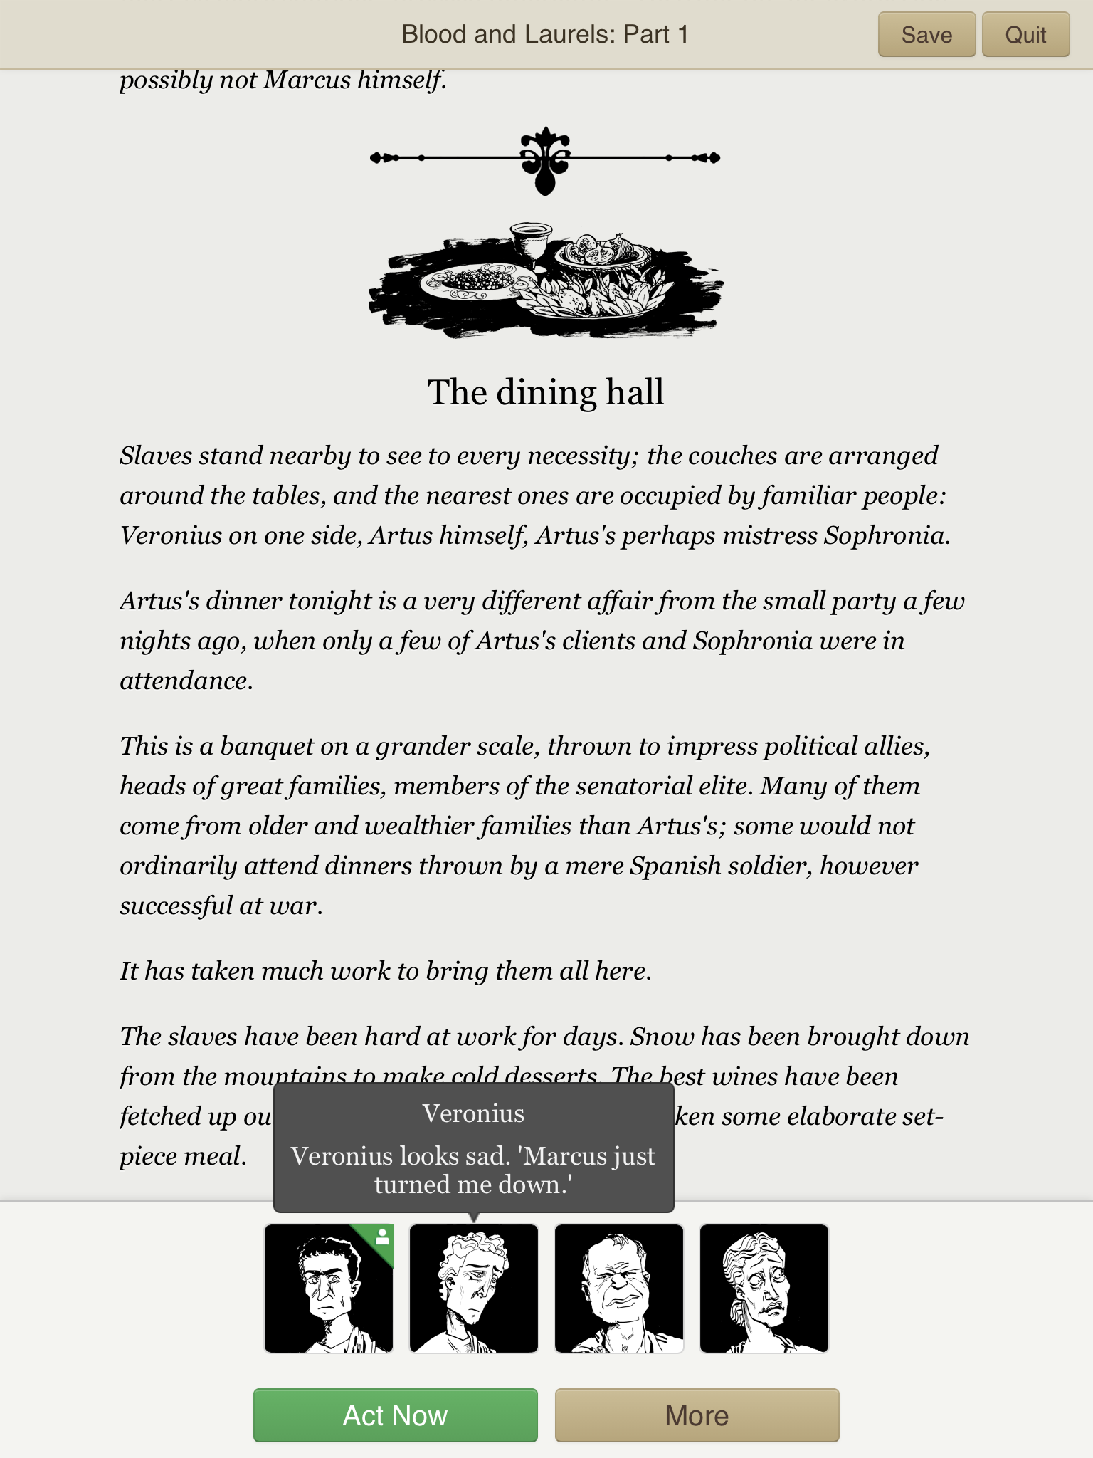

Slide 31
Finished Product Stats
2503 quips in ep 1, 2460 quips in ep 2: roughly 10x the content of Galatea or Alabaster
172 scenes in ep 1, 238 scenes in ep 2
240K words of Prompter script
Automated testing to discover scenes which did not conclude for some reason
Notes:
How B&L came out
size of game -- word count, number of scenes, similar information
tropes and concepts
screenshots
types of agency -- what to do and say, how to feel about things, character intention (shout out to Tanenbaums' paper?)

Slide 32
Ease of Authoring Content
Successes
  Rapid creation process
  Strong sense of flow
  Considerable variation within a scene
Problems
  Rotating agent responsibility in Versu made some dialogue bits inaccessible without hacking
Notes:
So again, we said we were going to look at ease of authoring, pacing and narrative coherence, and then two aspects of characterization, how much players were able to exercise agency through “social physics” and how believable the agents seemed to be.
Authorability and the conversation system
rapid creation process
strong sense of flow
satisfying variety of scenes created
-- possible to write a number of short threads that can be experienced in different orders, and in different quantities
-- e.g. poisoning as an example of something that works well
issue: rotating agent ID in Versu meant that it was nec. to do some hacking
to make particular bits of dialogue available

Slide 33
Pacing and Plot Coherence
There’s a great deal of room here to affect the pacing of a scene… [it offers] a wealth of tonal interactivity and allowance for subtle performance – PocketTactics

Slide 34
Pacing and Plot Coherence
There’s a great deal of room here to affect the pacing of a scene… [it offers] a wealth of tonal interactivity and allowance for subtle performance – PocketTactics
Blood & Laurels made me feel more like an improviser than a reader… – New York Times

Slide 35
Pacing and Plot Coherence
There’s a great deal of room here to affect the pacing of a scene… [it offers] a wealth of tonal interactivity and allowance for subtle performance – PocketTactics
Blood & Laurels made me feel more like an improviser than a reader… – New York Times
The interface gives a sense of kinesis to the story–something is always happening... the story is about being swept up in events much larger than yourself and attempting to gain control of them. -- Storycade

Slide 36
Pacing and Plot Coherence
Successes
  Pacing generally successful
Problems
  Juxtapositions of dialogue and setting investigation occasionally surprising
  Occasionally a player did not understand why a piece of dialogue became unavailable again; prototyped Versu Galatea UI addressed this
Notes:
Pacing
successful in most points except in scenes designated to be more sandboxy
-- allowing players room to explore generally not a success in cases where the system did not force an ending
not always successful: not always clear when you're close to pushing
a character towards a particular scene outcome
-- (still some objection that a piece of dialogue is available "but goes away again" when users don't understand the distinction between opportunistic and persistent dialogue choices; better UI prototyped for Galatea might help here)

Slide 37
Characters and Agency
When it works, it works. There are dinner parties where people will think you impetuous and rude if you talk too much, situations where you can act dumb in order to influence others to drop their guard, times where you have a choice between the same action with different motivations. – Storycade
Notes:
Characters and Agency
mixed success. people praised being able to see character thoughts and
expressions, but may not always have understood how character
manipulation tended to drive scenes
problem is not necessarily to do with small-scale emotional processes
emotional state-change stakes abstractly modeled are overall not that
satisfying (anger escalation, flirt escalation)
state-change stakes work best in tandem with the scene
in which they occu
Galatea for comparison: Galatea conversion including a larger number of
automated emotional cycles (e.g. getting angry and being forced to
react to anger before proceeding) did not produce a greater level of
believability
r

Slide 38
Characters and Agency
When it works, it works. There are dinner parties where people will think you impetuous and rude if you talk too much, situations where you can act dumb in order to influence others to drop their guard, times where you have a choice between the same action with different motivations. – Storycade
But: [Veronius’] relationship with Marcus doesn’t do much to affect the plot of Blood and Laurels. -- PocketTactics
Notes:
Characters and Agency
mixed success. people praised being able to see character thoughts and
expressions, but may not always have understood how character
manipulation tended to drive scenes
problem is not necessarily to do with small-scale emotional processes
emotional state-change stakes abstractly modeled are overall not that
satisfying (anger escalation, flirt escalation)
state-change stakes work best in tandem with the scene
in which they occu
Galatea for comparison: Galatea conversion including a larger number of
automated emotional cycles (e.g. getting angry and being forced to
react to anger before proceeding) did not produce a greater level of
believability
r

Slide 39
Characters and Agency
Successes
  Ability to see character thoughts and expressions helped
  “Pushing your luck” as a play experience was often satisfying
Problems
  Players did not always understand how character manipulation drove scenes
Notes:
Characters and Agency
mixed success. people praised being able to see character thoughts and
expressions, but may not always have understood how character
manipulation tended to drive scenes –
For instance, the PocketTactics review concluding that Veronius was basically an unnecessary character – well, no. There are a host of ways he can bend the plot, by betraying you intentionally or accidentally, or by getting killed himself in various circumstances and thus changing your relationship to your employer. But because the reviewer didn’t encounter those outcomes, he wasn’t aware that they existed; possibly, he wasn’t aware of what was at stake in some of the scenes he had with Veronius. So the perceived consequences of his actions aren’t there; perhaps he dodged a bullet by accident but it was one he never even knew was there.

Slide 40
Character Persuasiveness
Versu isn’t at the point where it’s able to make this emergent behavior interesting to read. The most obvious is in the realm of romance... all of them feel fairly perfunctory in execution… The vast, vast majority of Blood and Laurels‘s passages–the ones directly under the author’s control–are wonderful. The emergent bits feel like static. – Storycade
Notes:
Finally, on the issue of character persuasiveness, we have a complaint that came up in several reviews and that I have to confess makes me a little bit cross-eyed.
(Read)

Slide 41
Character Persuasiveness
[On occasion, t]he stars aligned such that the prose and the choices meshed in such a way that I felt I experienced a “text holodeck”. However, I’m fairly certain the parts I felt inspired by were heavily scripted. When Versu as an engine clearly took over… it hit solid as a rock. -- Jason Dyer
Notes:
(Read)
And here’s the thing. These are people who are really eager and excited to play with a story that has a lot of procedural possibility, but they don’t recognize that the engine is doing anything except when they have an experience that feels “broken”. All of the behind-the-scenes work of selecting which dialogue to use next, blending dialogue with gestures and elements from other social practices, representing the same social practice actions in different ways depending on scene context, inserting exposition automatically at the right moments – all that reads to these players as “scripted” and the engine gets none of the credit.

Slide 42
Character Persuasiveness
Problems
  Players rebelled against the reuse of “repeatable” bits of conversation
  Some social practices (flirtation, anger) felt too generic
Notes:
Persuasiveness of Characters
-- Players rebelled against the reuse of “repeatable” bits of conversation
-- points of contact between engine and prewritten narrative: differences in conversation selection by characters; differences in outcomes of particular scenes depending on what a character thought about you; dialogue call-backs to character's opinion of you
issue: players rebelled against "generic" bits of conversation being
reused by different characters; strong sense that this violated
expectations that each character will behave completely uniquely
Fundamental challenge here: making the mechanics more pervasive and more predictable would heighten the sense of character non-believability

Slide 43
Design Issue!
Too systematic?
Not systematic enough?
  Some social practices (flirtation, anger) felt too generic
  Players did not always understand how character manipulation drove scenes
Notes:
Persuasiveness of Characters
-- Players rebelled against the reuse of “repeatable” bits of conversation
-- points of contact between engine and prewritten narrative: differences in conversation selection by characters; differences in outcomes of particular scenes depending on what a character thought about you; dialogue call-backs to character's opinion of you
Galatea for comparison: Galatea conversion including a larger number of
automated emotional cycles (e.g. getting angry and being forced to
react to anger before proceeding) did not produce a greater level of
believability
Fundamental challenge here: making the mechanics more pervasive and more predictable would heighten the sense of character non-believability

Slide 44
Possible Future Solutions
Modeling narrative values explicitly in utility scoring
Multiplicative rather than additive approach to conversation and other social practices
More abstract visual clues for the player about narrative progress
Notes:
thoughts also about the experience of writing for the market?
Meretzky's feedback about wanting to be able to do both gestural actions and narratively significant actions
possible future solutions:
-- explicitly modeling narrative stakes: in simulated interactions, NPCs were not by any means guaranteed to do the most interesting thing available to them. Might matter less in e.g. sims

Slide 45
Multiplicative Approach
Additive
Multiplicative
Conversation
Ask Artus about cult
Tell Artus about the Emperor
Other Social Practices
Flatter Artus
Pose assertively
Sycophantically tell Artus about Emperor
Flatteringly ask Artus about cult
Assertively tell Artus about Emperor
Assertively ask Artus about cult
Notes:
-- multiplicative rather than additive approach (and talk about what that would mean)
-- drawbacks: either escalate the authoring load or use procedural text generation or drastically reduce the scope of what is being modeled in terms of interpersonal actions
-- would still also probably need a way to exclude non-useful multiplicatives
-- need to limit options on the player's screen?
But also has a number of advantages:
more affordances for the NPCs to choose from gives Versu’s preference calculations more to work with; make it possible for NPC behavior to demonstrate a richer range and also more emotional continuity with what’s gone before
stop forcing the player to choose between “advance the story” and “advance the relationship” (or even just “roleplay”) – this was something Steve Meretzky pointed out in his playtest of Blood & Laurels, that he basically wanted to be free to make one action of each kind during his move

Slide 46
Communicating Plot Position
Explicit but abstract visualization of possible endings for the current scene & how close NPCs are to committing to one of those endings
Notes:
Another thing I think might help provide a sense of procedural depth and possibility without overly mechanical writing would be to rely on abstractions presented via the UI. Blood & Laurels in its current design provides some visual information about the moods and attitudes of characters, but none for understanding the current narrative state or how character moods related to narrative outcomes.
So there might be some mileage in representing those ideas more explicitly. One of the most successful passages in Alabaster – and again, by successful I mean “the one players mentioned liking the most” – was one in which the player is asking a series of questions that are upsetting the main NPC, and with each turn that she gets more upset, the image collage on the side of the screen shows a more and more dark and thunderous expression. So the player has this clear sense of pushing her luck, which she can choose to pursue or not. Players said that they found that ominous and effective, somehow I think more so than if the text had explicitly said “you’re pushing your luck here”.
Obviously that’s a very directed example which is only trying to communicate information on a single axis, but we could imagine something that, for instance, >>

Slide 47
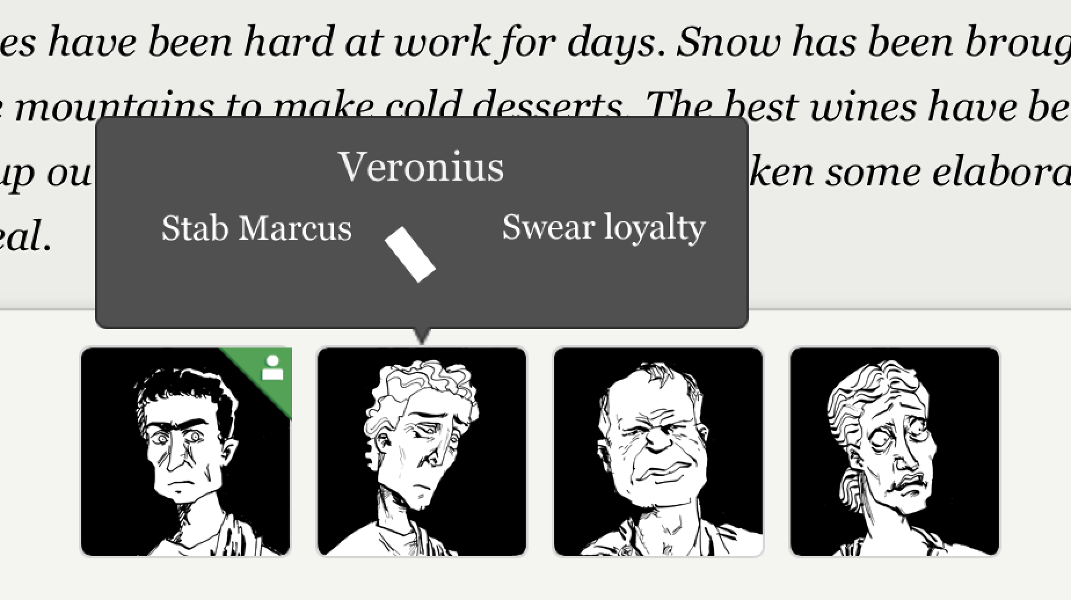
Communicating Plot Position
Explicit but abstract visualization of possible endings for the current scene & how close NPCs are to committing to one of those endings
Notes:
More explicitly indicated the possible outcomes of a scene and provided some indicator of how close you were to achieving one or the other.
Obviously not all scenes need this – as we saw, some scenes are primarily exploratory and others depend on direct choices by the player. But for the case of scenes where the player can control the outcome by manipulating NPCs, this might allow the player to exercise more agency and also be more aware of the procedural shape of the game, without loading additional work onto the main text.

Slide 48
Concluding Questions
If we’re modeling multiple kinds of system (narrative, agent relationships and emotions, conversation flow, protagonist intentions), which of these is most directly accessible to the player?
Notes:
I want to conclude by offering a few diagnostic questions that would have helped us discover these concerns with Blood & Laurels earlier in the design process and might guide us towards better practices in the future.
Here to some extent the player is allowed to push on *either* the relationships *or* the conversation, and only sometimes both at once. This produces a slightly broken sense of control.

Slide 49
Concluding Questions
If we’re modeling multiple kinds of system (narrative, agent relationships and emotions, conversation flow, protagonist intentions), which of these is most directly accessible to the player?
Does the player understand how these systems fit together? Does the UI support that understanding?

Slide 50
Concluding Questions
If we’re modeling multiple kinds of system (narrative, agent relationships and emotions, conversation flow, protagonist intentions), which of these is most directly accessible to the player?
Does the player understand how these systems fit together? Does the UI support that understanding?
Which offers the highest fidelity? Are other, lower-fidelity systems providing output in the same channel?

Slide 51
Resources
Versu.com – papers on Versu and Prompter
“Threaded Conversation” library for Inform 7
Emshort.wordpress.com – my writing on interactive storytelling, including “conversation” subcategory for articles and post mortems on conversation projects
emshortif@gmail.com or @emshort to contact me

